Slide 1
Academical++, Professional++, Social++
[True Education -> Software Engineering]
[Distinguished Facilitator]
Dr. Brijesh S. Bhatt (brij.ce@ddu.ac.in)
Prof. Jigar M. Pandya (jigarpandya.ce@ddu.ac.in)
Department of Computer Engineering
Faculty of Technology
DHARMSINH DESAI UNIVERSITY, NADIAD.
** This is a department activity. All staff members and students are involved in some or other initiative directly or indirectly.
**Topics covered are not the sole list of activities.
1

Slide 2
Section I- Background and Description of the achievement
Academical++, Professional++, Social++
If an individual has reached the peak of any one from Academics, Professionalism or Society but has not made remarkable ground for remaining then success dwells in vain.
Value added growth Academically, Professionally and Socially is must for the true balance. The Department of Computer Engineering, FoT. DDU. has established objectives to attain all below for students and faculties.
Self development by strong academics
Group development by improved professionalism
Society development by innovative technical solutions
2

Slide 3
Section II - Justification
Academical++, Strengthening Academics Differently:
MOOC (Massive Open Online Course) Days for M.Tech C.E.
Students themselves choose topics for which MOOC seems helping them differently.
Total 11 such sessions (Videos) conducted during IV semester 2016_17
Students have learnt topics from internal faculties with certain example scenarios but Mooc on the same/similar topic explained the concept differently and hence students gained different insight of the topic learnt.
3

Slide 4
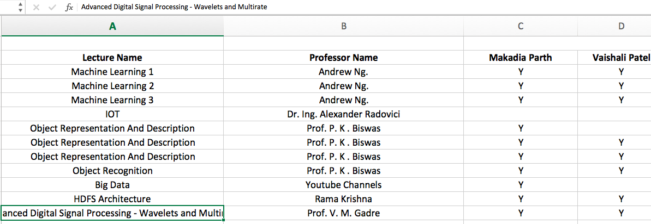
Section II - Justification
Academical++, Strengthening Academics Differently:
List of MOOC Sessions
Student “Makadia Parth” (Gate Qualified) secured UGC scholarship for his M.Tech.
He worked on Hadoop File System during dissertation.
4

Slide 5
Section II - Justification
Academical++, Strengthening Academics Differently:
Connecting and aligning Research/Technical Solutions:
Student (Junior), who researched on Game Bot, Steganography and wishes to continue AI/NLP is being connected to students (Seniors), who did internship at IIT Bombay on similar topics.
Extended work by a team for confidential conversations using security algorithms and techniques; Connecting the past and current students’ work.
“You can't connect the dots looking forward; you can only connect them looking backwards.” - Steve Jobs
5

Slide 6
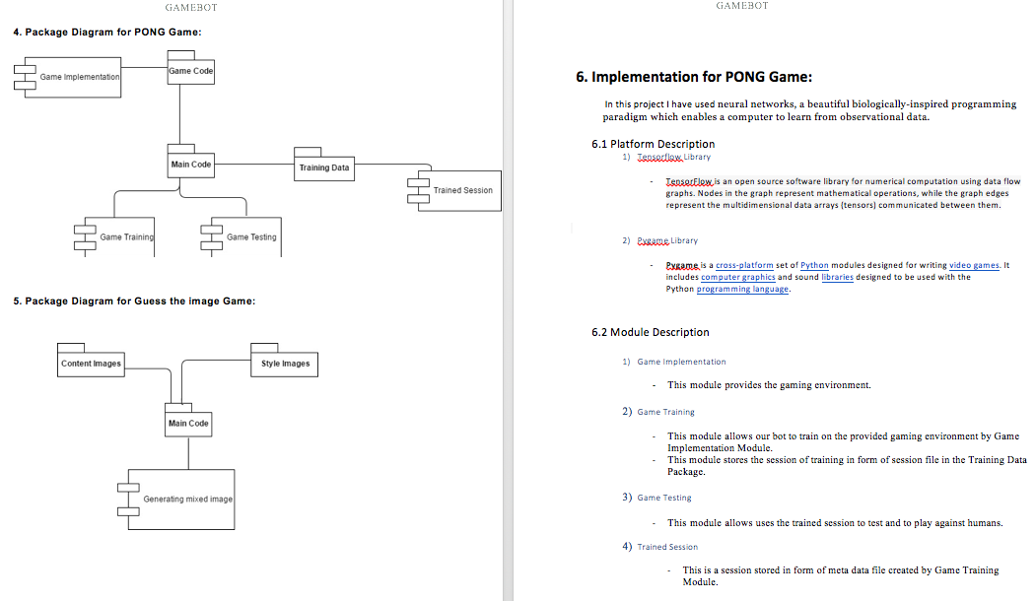
Section II - Justification
Academical++, Strengthening Academics Differently:
Game Bot – Research/Development AI/Stegnography
6

Slide 7
Section II - Justification
Professional++, Following latest technological trends professionally
For and by Students ( From Identified Learning Sources - other than faculties )
A talk for the next batch by Amazon India selected Interns: "Getting ready for interview”
Seminar on Oracle ERP, co-operated by Infosys Campus Connect and delivered by Infosys Industry Expert
Internet of Things (IOT): Interactions of sensors, actuators, hypothetical smartness and programmable models by Educational Institute
Angular JS session by Professional Trainers
Rollout of Foundation Program, developed and designed by Infosys Campus Connect, Success Partners.
7

Slide 8
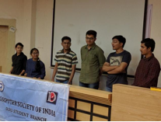
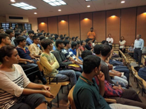
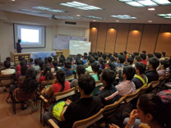
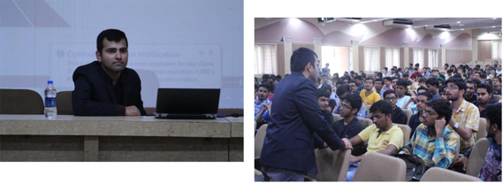
Section II - Justification
Professional++, Following latest technological trends professionally
Amazon India – Selected Interns
Sharing interview experience
Seminar & Student Interaction on Latest Technologies (ERP, Cloud)
8

Slide 9
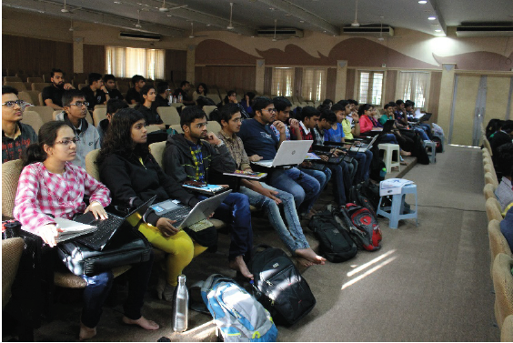
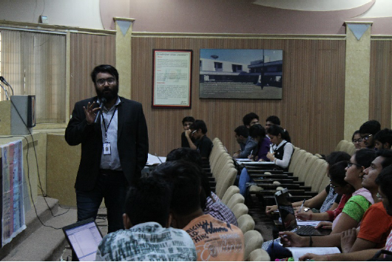
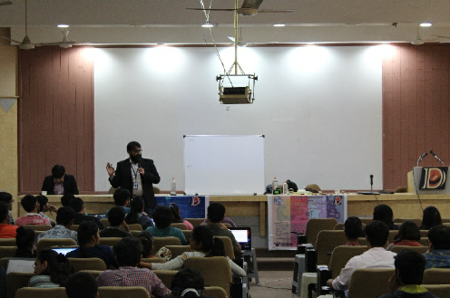
Section II - Justification
Professional++, Following latest technological trends professionally
Students’ experience: Internet of Things (IoT)
9

Slide 10
Section II - Justification
Professional++, Following latest technological trends professionally
For and by Faculties
Ownership of expertise, faculties are given roles to play and achieve milestones technically. i.e. setting up hadoop, hbase, latest with .Net, Node/Angular JS, Cloud – Setting up DokuWiki, etc.
Faculties come together for discussion and knowledge sharing about latest trends in software industry.
i.e. Hadoop Eco System Group successfully demonstrated Hadoop and HBase applications.
DokuWiki for content management pertaining to group activities such about exploring Hadoop Eco System.
Systems Team worked to have Hadoop (Pseudo Distributed) ready laboratories based on the provided Software Deployment Document (SVDD).
Total 6 “Let’s learn” session and bookkeeping efforts easily generated 3-5 days Hadoop STTP worth material on DokuWiki.
10

Slide 11
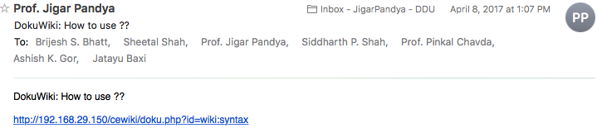
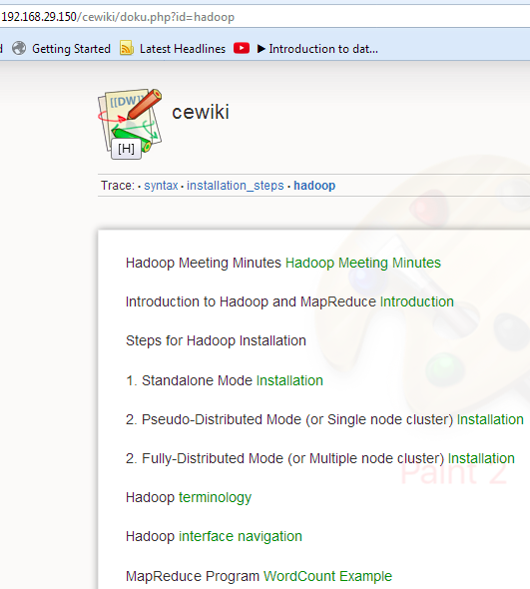
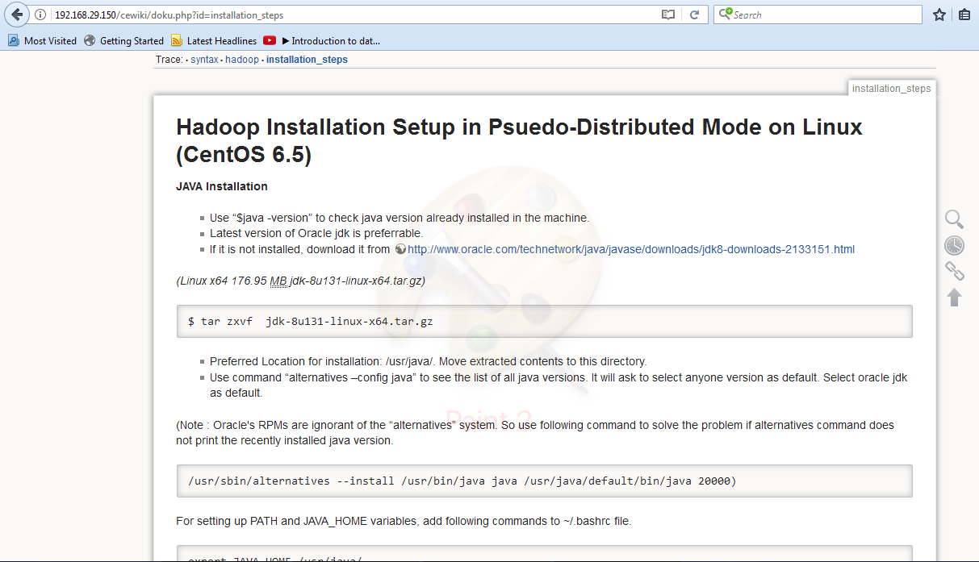
Section II - Justification
Professional++, Following latest technological trends professionally
DokuWiki
11

Slide 12
Section II - Justification
Social++, Committed for building next generation community
Proposing software solutions year by year on different agenda.
Women Safety - Development of a mobile app with all safety concerns pertaining to women.
p.s. Industry Leaders examined and acclaimed this efforts.
Student, who developed was awarded higher rankings.
Growing Together – Supporting Training sessions of basic computer knowledge for non-technical staff and school crowd.
12

Slide 13
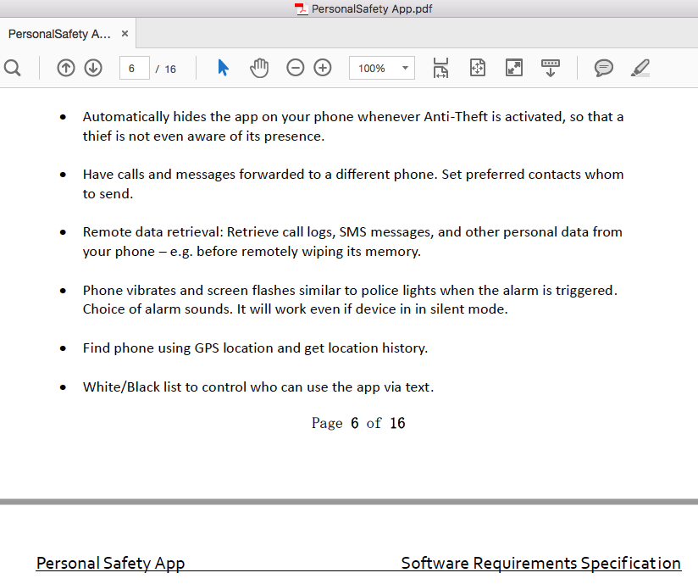
Section II - Justification
Social++, Committed for building next generation community
Personal Safety App – Features
13

Slide 14
Section III - Conclusion
Students get to learn different aspects and purposes from non-traditional sources like MOOC, immediate seniors, interns, professional trainers, industry experts, Educational Institutes, Success Partners.
Faculties get to develop while teaching and staying with the cutting edge technologies. Expanding the thought process beyond just reading text books, referring same old notes, etc.
“The goal of education is to manifest the divinity within.”
- Quoted in book, ‘Saving Humanity: Swami Vivekanand Perspective’
And as understood by current generation, HUMANITY is DIVINITY.
Hence, by improvising upon Academics, Professionalism and Societal Solutions, we are imparting true education to oneself to save humanity.
11

Slide 15

References
https://www.dokuwiki.org/dokuwiki#
https://onlinecourses.nptel.ac.in/explorer
https://books.google.co.in/books?id=hkzL6loGmEIC
https://www.forbes.com/sites/ericjackson/2011/10/05/the-top-ten-lessons-steve-jobs-taught-us/#3f33c4e77bfb
https://en.wikipedia.org/wiki/RGB_color_model
15

Slide 16
THANK YOU www.ddu.ac.in
16
Notes:
To reproduce this slide simply create a new slide, right click and select layout and apply the Notes&Disclaimer layout.

